Slide 1
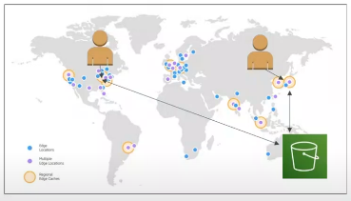
Amazon CloudFront
• Content Delivery Network (CDN)
• Improves read performance, content
is cached at the edge
• Improves users experience
• 216 Point of Presence globally (edge
locations)
• DDoS protection (because
worldwide), integration with Shield,
AWS Web Application Firewall

Slide 2
CloudFront - Origins
• S3 bucket
• For distributing files and caching them at the edge
• Enhanced security with CloudFront Origin Access Control (OAC)
• OAC is replacing Origin Access Identity (OAI)
• CloudFront can be used as an ingress (to upload files to S3)
• Custom origin (HTTP)
• Application Load Balancer
• EC2 instance
• S3 website (must first enable the bucket as a static S3 website)

Slide 3
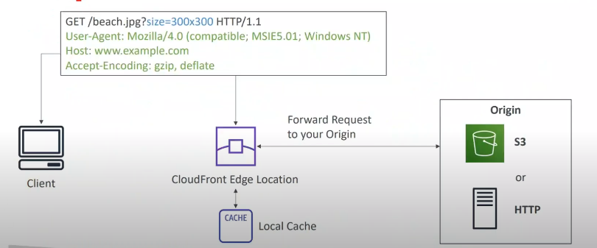
How CloudFront Works?(High Level)

Slide 4
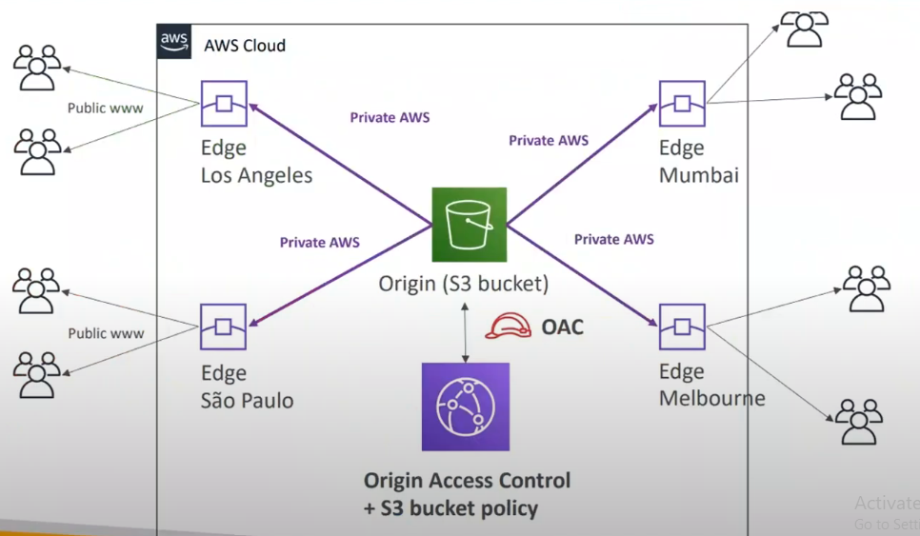
CloudFront - S3 as an Origin

Slide 5
CloudFront vs S3 Cross Region Replication
• CloudFront:
• Global Edge network
• Files are cached for a TTL (maybe a day)
• Great for static content that must be available everywhere
• S3 Cross Region Replication:
• Must be setup for each region you want replication to happen
• Files are updated in near real-time
• Read only
• Great for dynamic content that needs to be available at low-latency in
few regions

Slide 6
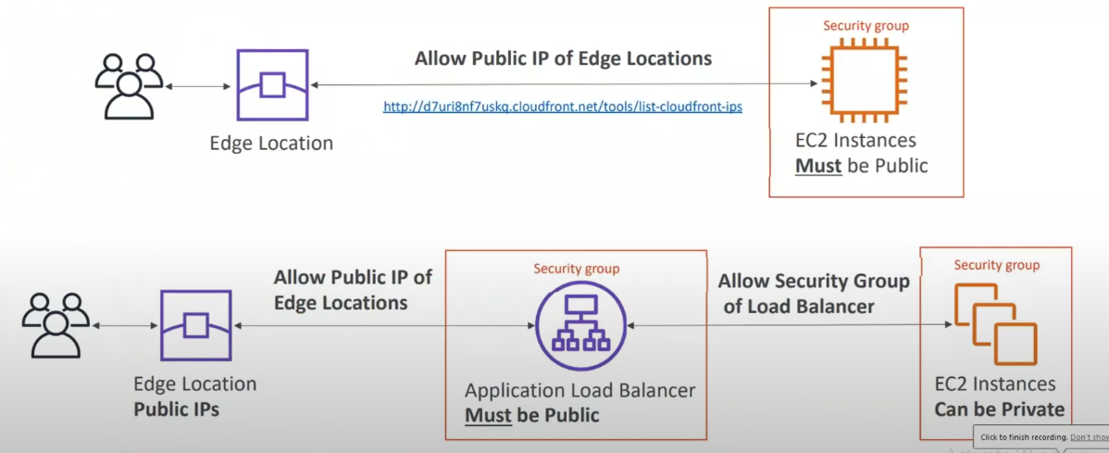
CloudFront - ALB or EC2 as an origin

Slide 7
CloudFront Geo Restriction
• You can restrict who can access your distribution
• Allowlist: Allow your users to access your content only if they're in
one of the
countries on a list of approved countries.
• Blocklist: Prevent your users from accessing your content if they're
in one of the
countries on a list of banned countries.
• The "country" is determined using a 3rd party Geo-IP database
• Use case: Copy right Laws to control access to content

